Slide 1



Predicting Customer Bookings
A Machine Learning Approach with CatBoost and SMOTE

Slide 2
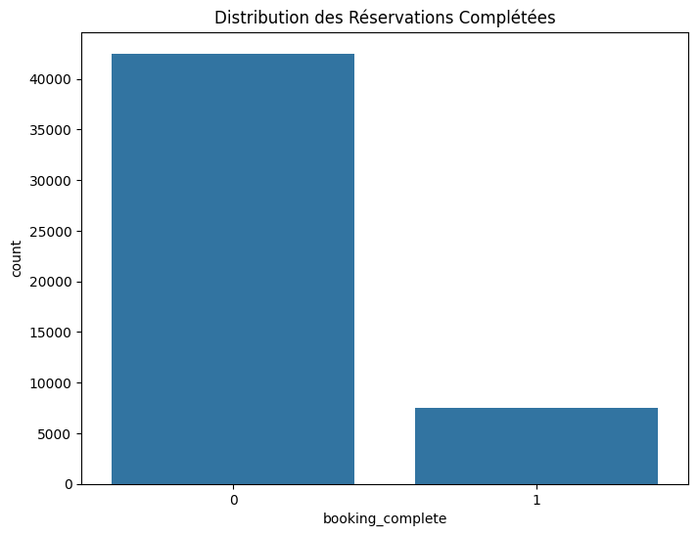
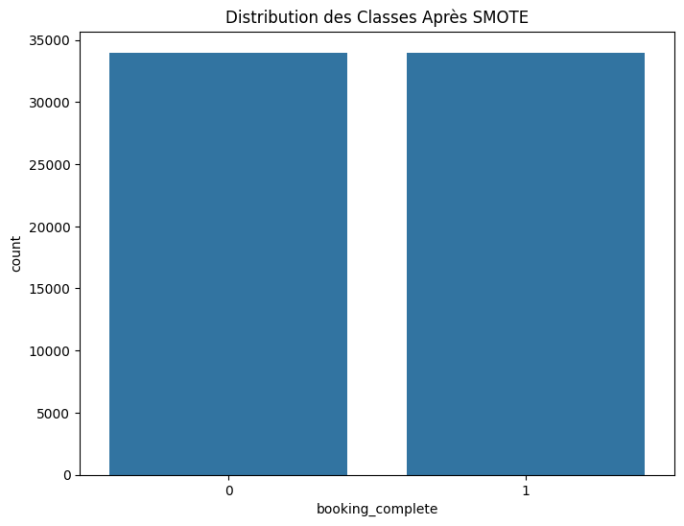
Context and Data Preparation
Objective:
Predict whether a customer will complete a booking (booking_complete = 1) or not (booking_complete = 0).
Dataset:
Size: 50,000 entries, 14 columns.
Key Features: num_passengers, purchase_lead, length_of_stay, flight_hour, etc.
Class Imbalance Issue:
85% non-completed bookings.
15% completed bookings.
Data Preparation:
Encoding categorical variables (One-Hot Encoding).
Resampling with SMOTE to balance the classes.
Data split: 80% training, 20% testing.

Slide 3
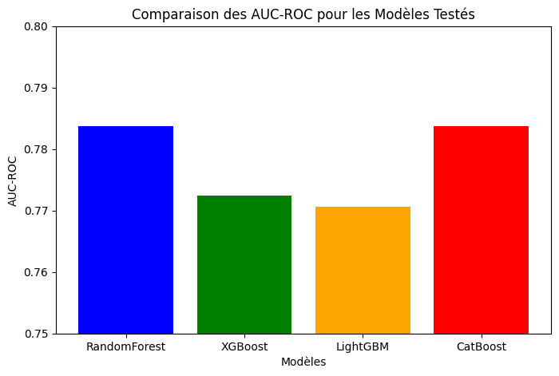
Models Tested:
RandomForest:
Accuracy: 84.35%.
Low recall (0.23) for the minority class.
XGBoost:
Improved recall (0.77).
AUC-ROC: 0.7724.
LightGBM:
Recall: 0.82.
AUC-ROC: 0.7706.
CatBoost:
Best overall performance.
AUC-ROC: 0.7837.
Key Results:
AUC-ROC:
RandomForest: 0.7837.
XGBoost: 0.7724.
LightGBM: 0.7706.
CatBoost: 0.7837.
Recall for Minority Class:
RandomForest: 0.23.
XGBoost: 0.77.
LightGBM: 0.82.
CatBoost: 0.79.
Model Performance

Slide 4

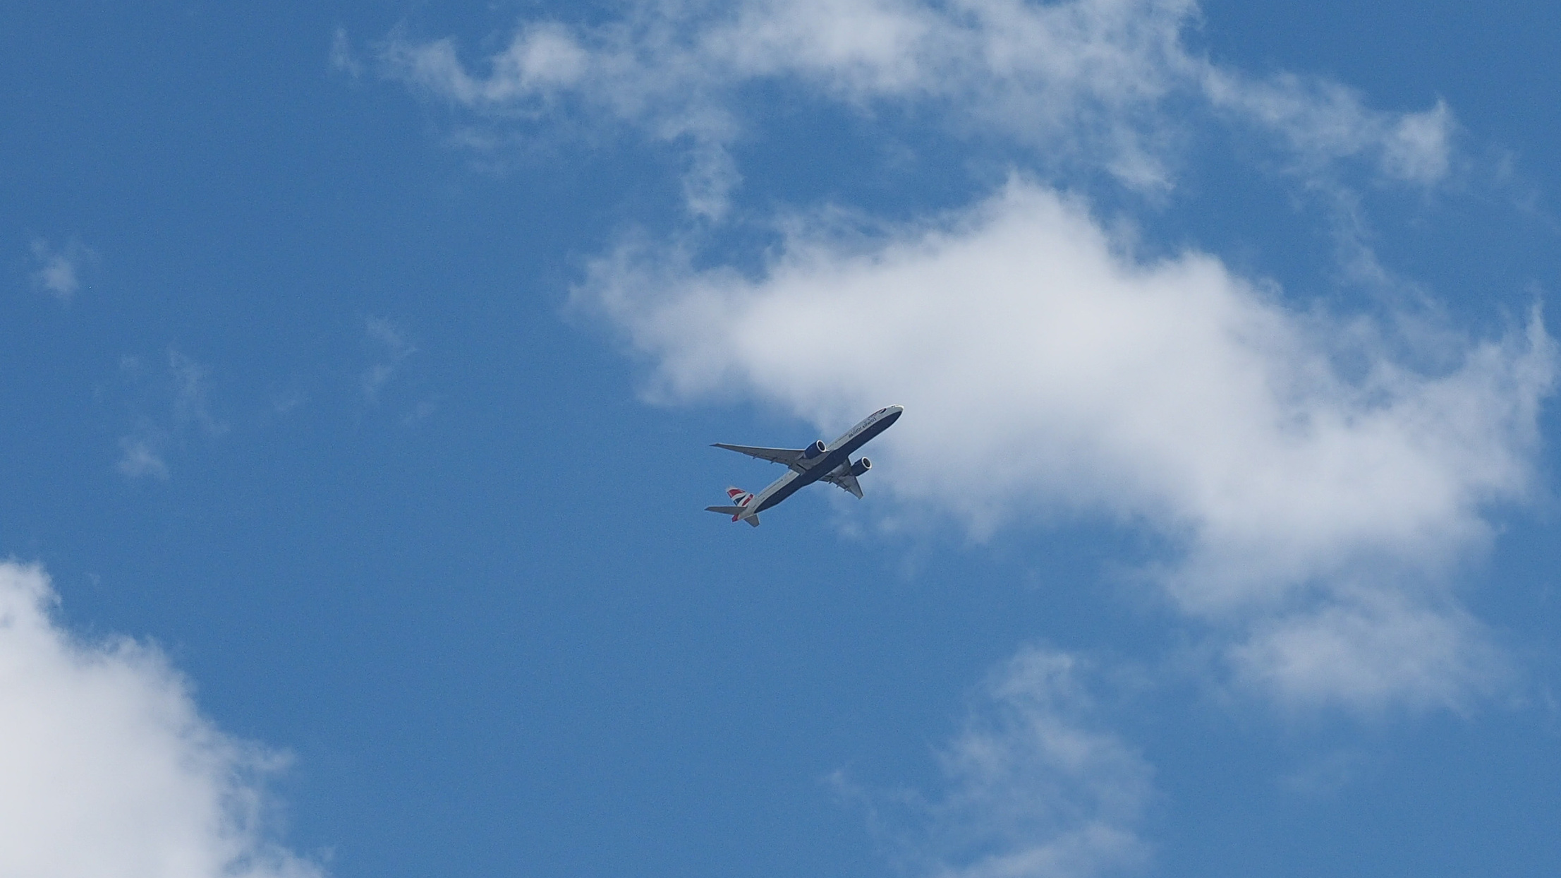
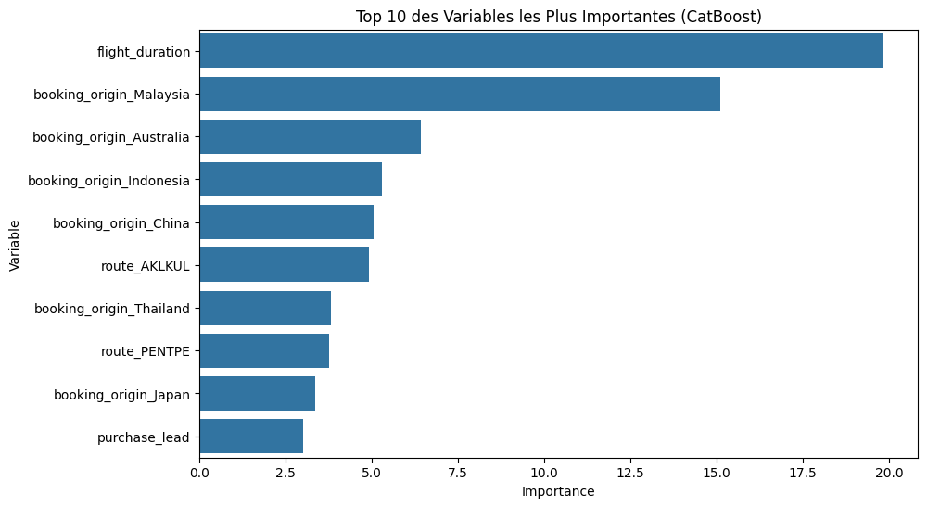
Recommendations and Conclusion
Recommendations:
Use CatBoost as the final model due to its superior overall performance.
Continue using SMOTE to address class imbalance.
Explore other resampling techniques like ADASYN.
Fine-tune CatBoost hyperparameters for further optimization.
Next Steps:
Deploy the model in production.
Monitor real-time performance.
Explore other algorithms (e.g., Gradient Boosting) for additional improvements.
Conclusion:
The CatBoost model with SMOTE provides the best ability to predict completed bookings.
Results show significant improvement in recall for the minority class.
CatBoost + SMOTE: Best Performance with an AUC-ROC of 0.7837.

Slide 5




THANK YOU
+21-77-577-85-07
gabardiop1@outlook.com

